Slide 1


CIVITAS
Civic Accountability Platform
Hold Power. Amplify People. Strengthen Democracy.
TEAM NAGRIKS:-
HARSH NALAWADE SIDDHI LOKHANDE
PRACHI PANDIT
Democracy should work every day — not just on election day

Slide 2





THE PROBLEM
Why governance is broken between elections
No Promise Tracking
Broken Complaint Systems
Politicians make hundreds of promises during campaigns. Once elected, there is no structured system to monitor, record, or evaluate whether those commitments are fulfilled.
Citizens have no reliable channel to report civic issues — broken roads, water failures, power outages — or to follow up on whether their complaints were ever resolved.
Opaque Public Spending
Inactive Democracy
Government budgets and expenditure data are rarely accessible to ordinary citizens, enabling misuse of public funds with zero community oversight or accountability.
Citizen engagement collapses after election day. Without ongoing participation tools, democracy becomes a 5-year event rather than a living system of daily accountability.

Slide 3




OUR SOLUTION
CIVITAS is a unified digital civic platform that bridges the gap between citizens and their elected officials — creating a continuous loop of accountability, transparency, and participation.
Real-time tracking of political promises and official performance scores
Structured civic complaint system with deadlines and escalation paths
Transparent access to government financial data and public spending
Open public discussion forums to enable informed civic debate
One platform. Four pillars. Endless accountability.

Slide 4
KEY FEATURES
AUTHORIZATION
OPINION
Performance Scoring
Issue Reporting
Officials earn points for completing commitments on time and lose points for delays and failures. Scores are public, transparent, and updated in real-time — creating direct accountability pressure.
Citizens upload civic issues with geo-tagged photos. The system automatically routes complaints to the responsible authority with assigned deadlines, automatic escalation, and resolution confirmation.
ASSEMBLY
FINANCIAL RESERVE
Public Discussion
Financial Transparency
A moderated civic forum where residents, officials, and subject experts can debate local policies, budgets, and proposals — turning passive observers into active democratic participants.
A dashboard that aggregates public spending data, budget allocations, tender outcomes, and expenditure reports — making government finances fully auditable by citizens and journalists.

Slide 5
HOW OPINION WORKS
The Civic Issue Resolution Engine
01
02
03
04
05
Report
Route
Deadline
Escalate
Resolve
Citizen uploads an issue with a photo and GPS-tagged location via mobile or web app.
AI system identifies the responsible authority (municipality, district, ward) and automatically assigns the complaint.
A resolution deadline is set based on issue severity and authority SLA. Both citizen and official are notified.
If unresolved past deadline, the issue auto-escalates to higher authorities and becomes visible on the public dashboard.
The official marks the issue as resolved. The citizen receives a notification and confirms — closing the accountability loop.

Slide 6
AUTHORIZATION SCORING SYSTEM
Every elected official and government officer has a live, publicly viewable AUTHORIZATION score — an objective performance rating built from real civic data.
✅ Promise fulfilled on time
+15 pts
✅ Civic complaint resolved before deadline
+10 pts
✅ Budget released transparently
+8 pts
⚠️ Complaint deadline missed (1st time)
−5 pts
❌ Promise broken or withdrawn
−20 pts
❌ Repeated unresolved complaints
−15 pts
Low MANDAAT scores trigger public alerts, media visibility, and formal review processes by independent auditors.

Slide 7
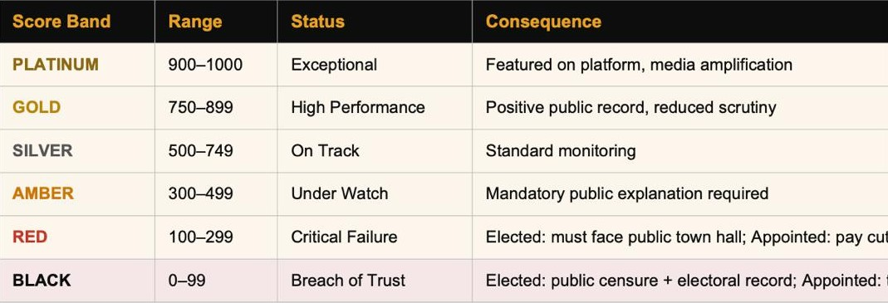
AUTHORIZATION : THE SCORING SYSTEM
The heart of CIVITAS. AUTHORIZATION translates governance performance into a real-time, public-facing score for every elected and appointed official. This score is persistent, transparent, and tied to real consequences.
Score Architecture

Slide 8
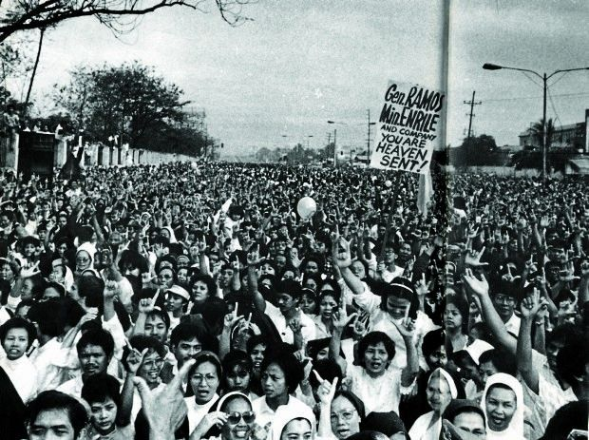
WHO USES CIVITAS?
Citizens
Politicians
Govt Officers
Auditors
Report civic issues with evidence
Respond to constituent complaints
Receive routed issue assignments
Cross-verify spending data
Track elected officials' performance
Publish and update promises
Set resolution timelines
Flag suspicious transactions
Participate in public ASSEMBLY debates
Improve AUTHORIZATION score publicly
Update complaint status
Independent performance review
Verify government spending data
Demonstrate governance record
Manage departmental accountability
Issue accountability reports

Slide 9
IMPACT & OUTCOMES
3×
60%
↓40%
2×
Accountability
Participation
Corruption
Trust
More officials fulfill promises when performance is publicly tracked vs. when it is not.
Increase in civic engagement when residents have structured, easy-to-use reporting tools.
Reduction in misuse of public funds when spending data is open and auditable by citizens.
Rise in public trust in local government institutions within two years of platform adoption.

Slide 10
ROLLOUT ROADMAP
Phase 1
Phase 2
Phase 3
Phase 4
City Pilot
Multi-City
State-Wide
National & Global
Year 1
Year 2
Year 3
Year 4-5
Launch in 1 city
Expand to 5 major cities
Full FINANCIAL RESERVE financial module
National platform rollout
Core features: OPINION + AUTHORIZATION
Add ASSEMBLY discussion forums
State government integration
All 28 Indian states
Onboard 10,000 citizens
Mobile app full release
1M users across 50+ cities
Expand to South Asia & Africa
Partner with local municipality
Media partnership for score transparency
API open for civic developers
UN civic tech partnership
Collect feedback & iterate
100,000 active users
Auditor certification program
10M+ active citizens

Slide 11
CIVITAS
Democracy. Every Day.
Citizens become active stakeholders, not passive voters.
Officials are held accountable 365 days a year.
Governance becomes transparent, measurable, and trusted.
Hold Power. Amplify People. Strengthen Democracy.

